Slide 1
Modification on Base Paper and Further work
A Reliable Multicast Transport Protocol for Device Management in Space-ground Integrated Network

Slide 2
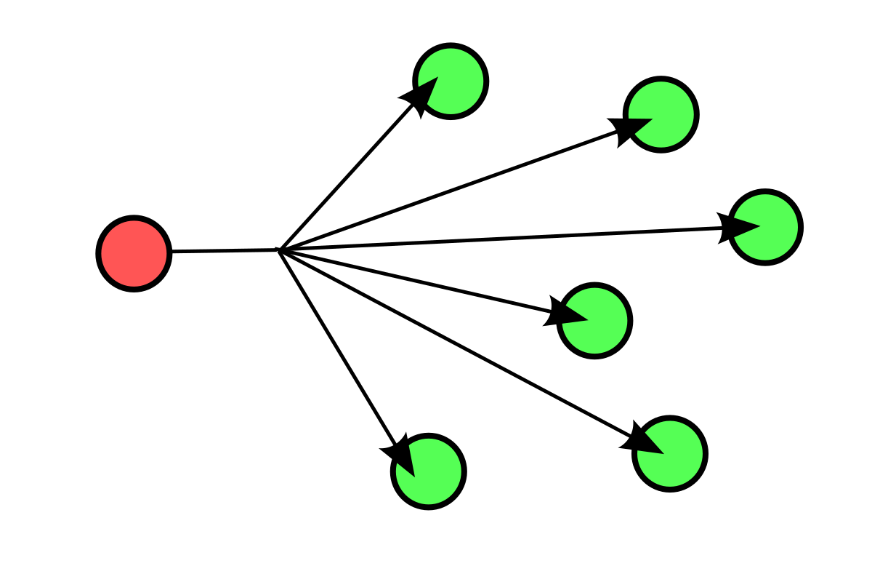
Broadcasting Implementation :
We implemented a Broadcasting Network based on Ad hoc On-Demand Distance Vector Routing Protocol.
This can be used when Multicast Transport Protocol is not feasible with networking conditions as illustrated in later part of Base Paper.

Slide 3
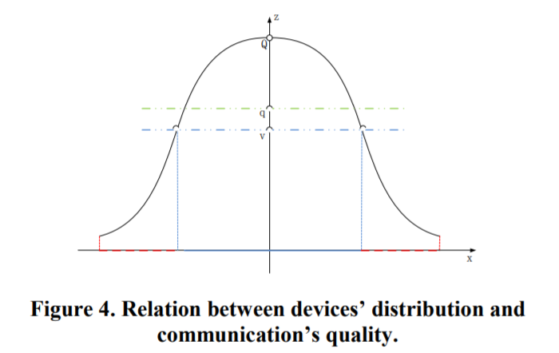
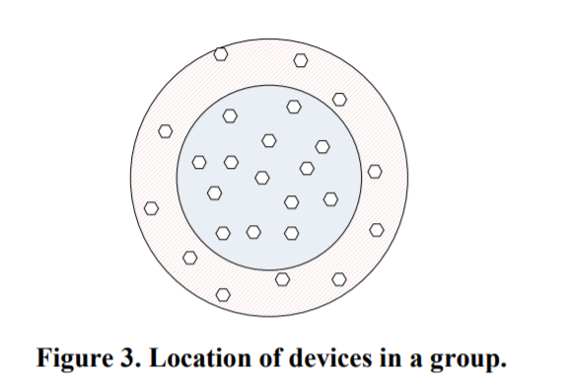

The number of the failed nodes is larger than the 1/3 of the total devices in the group, and a broadcast relay is more effective for the group. Otherwise, that means the number of the failed nodes is less the 1/3 of them, and relaying in multicast tree suits better in the group.

Slide 4
Vehicular Ad Hoc Networks:
VANET is a particular case of wireless multihop network, which has the constraint of fast topology changes due to the high node mobility .
With the increasing number of vehicles equipped with computing technologies and wireless communication devices, inter-vehicle communication is becoming a promising field of research, standardization, and development.
VANETs enable a wide range of applications, such as prevention of collisions, safety, blind crossing, dynamic route scheduling, real-time traffic condition monitoring, etc. Another important application for VANETs is providing Internet connectivity to vehicular nodes.

Slide 5
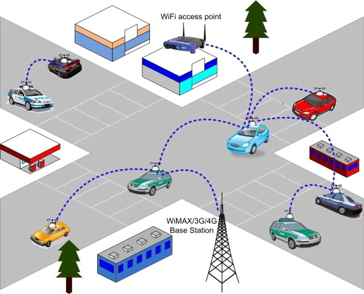

Slide 6
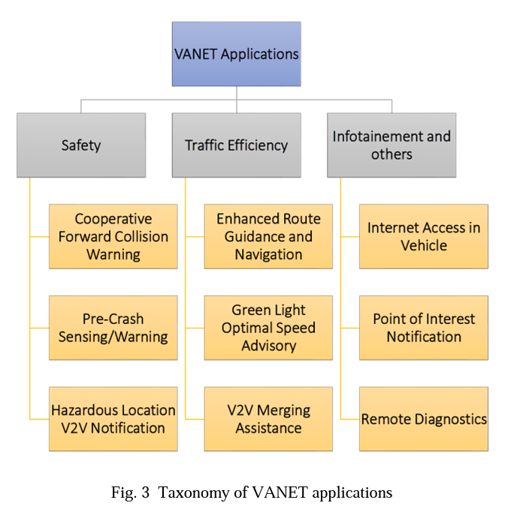
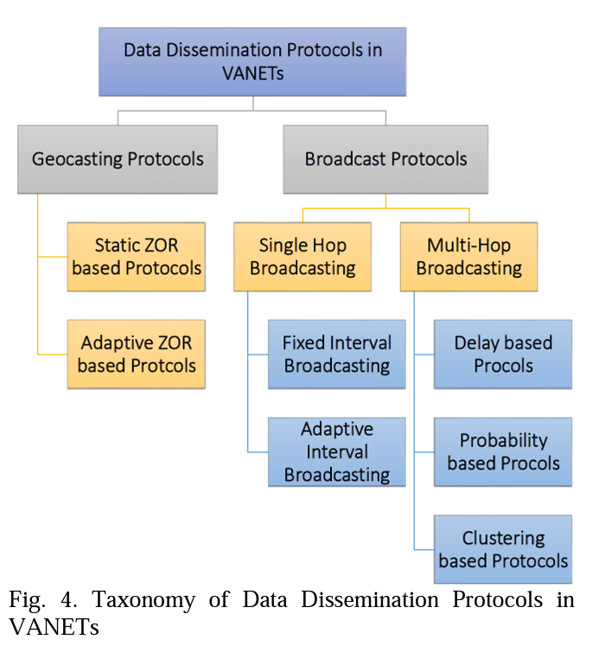

Slide 7
K-Means Clustering Algorithm and Continuous Hopfield Network for VANET
To ensure efficient data transmission between vehicles, a reliable routing protocol is considered a significant challenge.
This is an attempt to exploit clustering-based routing protocol combining a modified K-Means algorithm with Continuous Hopfield Network and Maximum Stable Set Problem (KMRP) for VANET.
In this way, the basic input parameters of the K-Means algorithm, such as the number of clusters and the initial cluster heads, will not be selected randomly, but using Maximum Stable Set Problem and Continuous Hopfield Network.
Then the assignment of vehicles to clusters will be carried out according to Link Reliability Model as a metric that replaces the distance parameter in the K-Means algorithm. Finally, the cluster head is selected by weight function according to the amount of free buffer space, the speed, and the node degree.

Slide 8
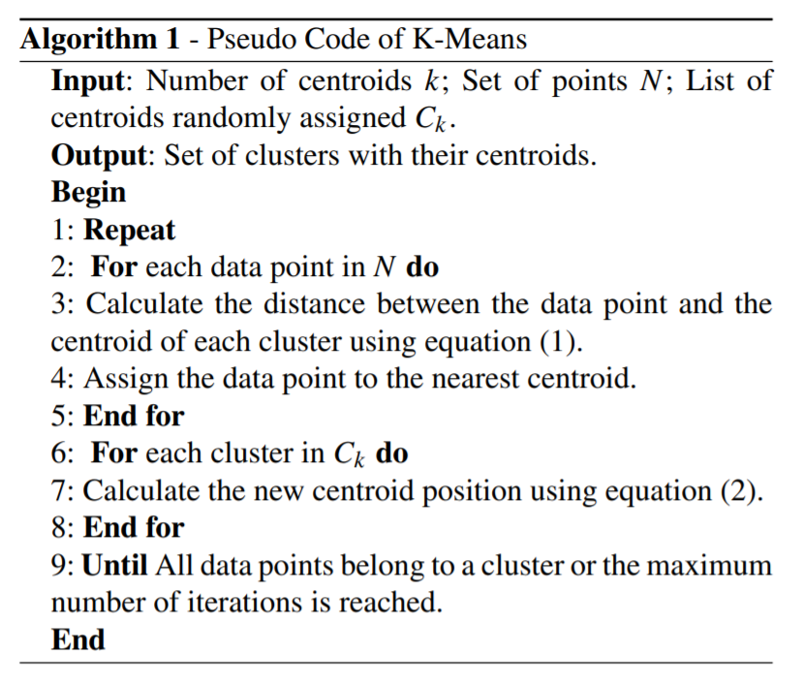
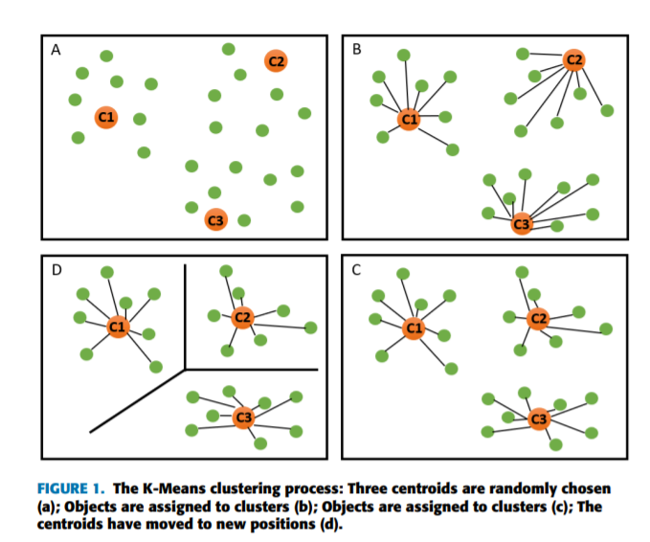

Slide 9
